Slide 1
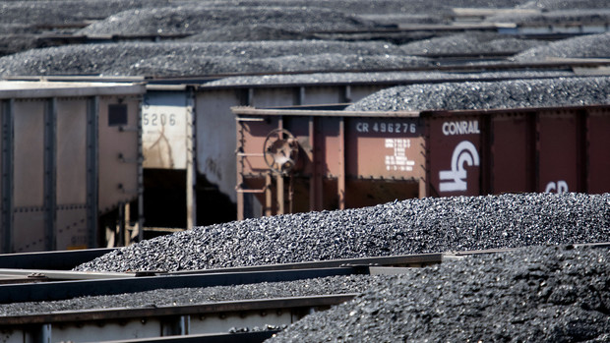
Cheap oil jamming rails
Despite the fact that U.S has the largest coal reserves in the world, its cost of electricity is high due to its poor system of coal transportation.
Notes:
Despite the fact that U.S as a country has the largest coal reserves in the entire world, it is projected that there will still have the lowest number of stockpiles since the year 2005. Major power producers such as Xcel Energy Inc. (XEL) claim that the amount of coal they receive is not sufficient. The delays in rail confirm that the utilities have not yet build inventories that fell drastically to seven year low during winter. This has prompted the utilities to opt using an alternative which is majorly natural gas which at the end increases the cost to consumers.

